Slide 1
Group No : 2 Section : 1 CSS-FLEXBOX

Slide 2


Team Members:
Akhitha Tumula
Mahender Reddy Surkanti
RethimaReddy Polam
Rohan Goud Bhandari

Slide 3
Agenda :
What is CSS Grid and CSS FlexBox
FlexBox
FlexBox Properties
Grid
Grid Properties
Demo

Slide 4
WHAT IS CSS GRID and FLEXBOX:
Most web pages are written in a combination of HTML and CSS.
CSS specifies how a web page looks its colors, fonts, formatting, layout, and styling.
CSS flex-box and Grid layout are particular ways to specify the layout of HTML pages.
Flex boxes can adjust in size either decreasing, to avoid unnecessarily monopolizing space, or increasing to make room for contents to be constrained within its boundaries.

Slide 5
Terminology of FlexBox
The flex container properties are:
1. flex-directions
2. flex-wrap
3. justify contents
4. align-items
5. align-contents
6. flex
7. order
8. flex-grow
9. flex-shrink
10. flex-basis
11. align-self

Slide 6
Flex-Directions
The flex-direction property defines in which direction the container wants to stack the flex items.
Their are different directions we can use in this like
a. column view
b. row view
c. column-reverse
d. row-reverse

Slide 7
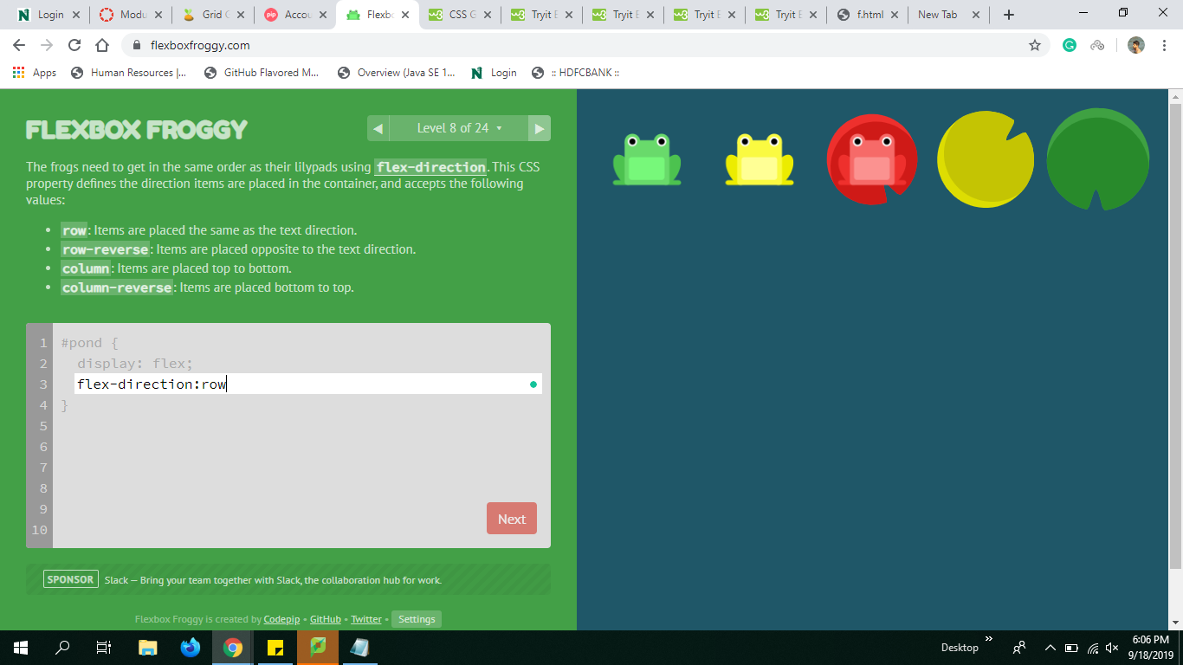
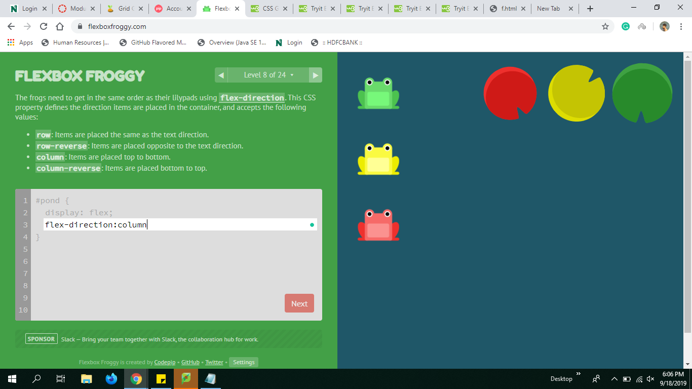
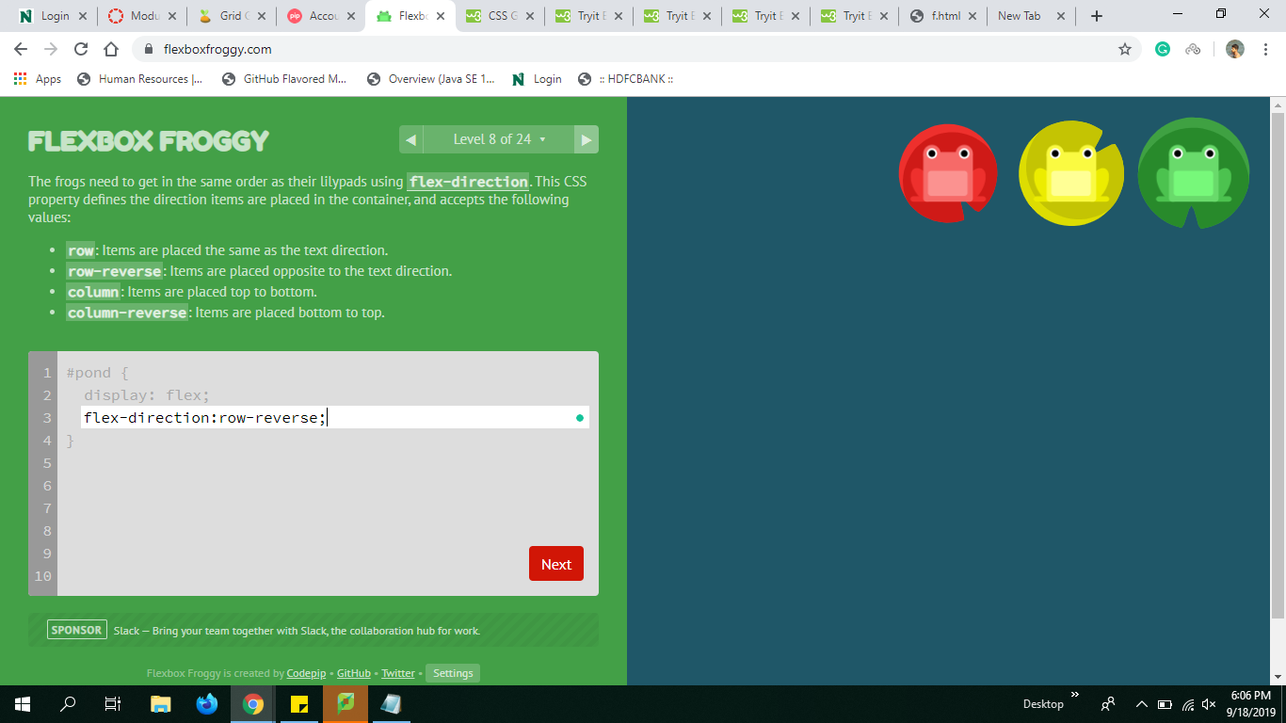
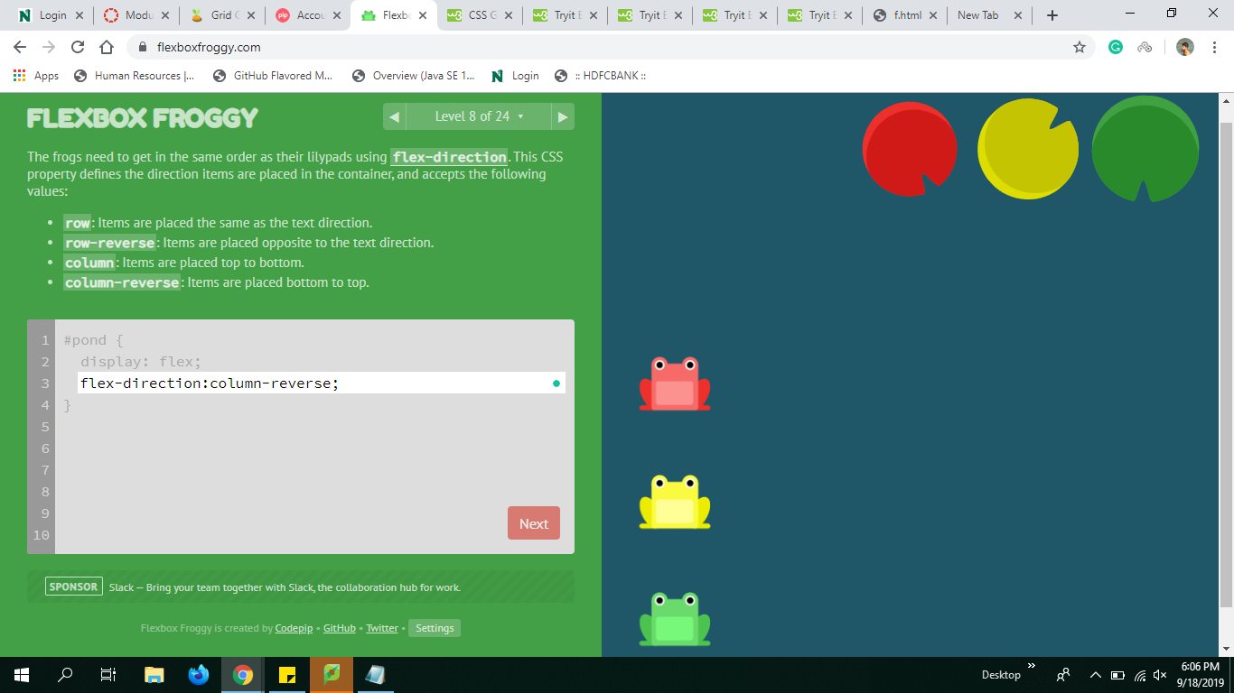
Flex-Direction
Row Column
Row-reverse Column-reverse

Slide 8
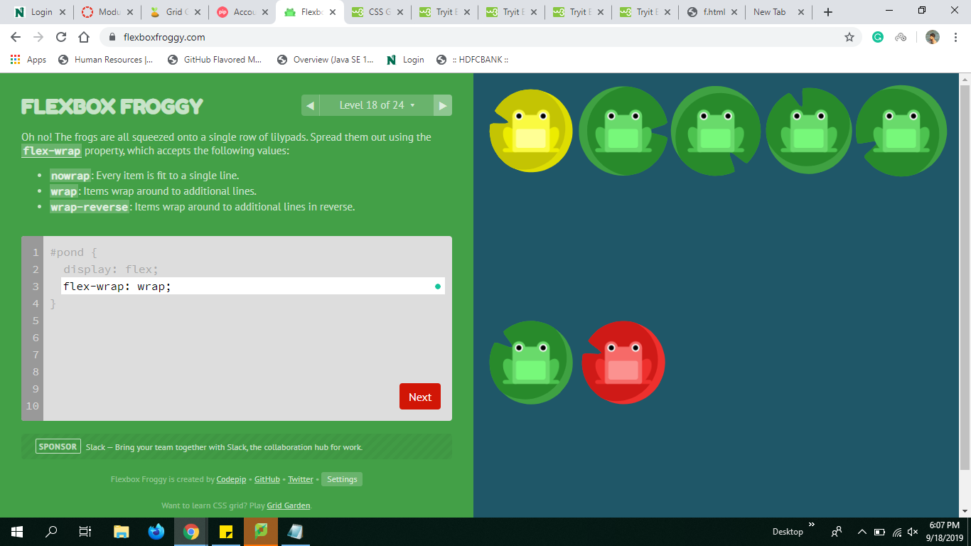
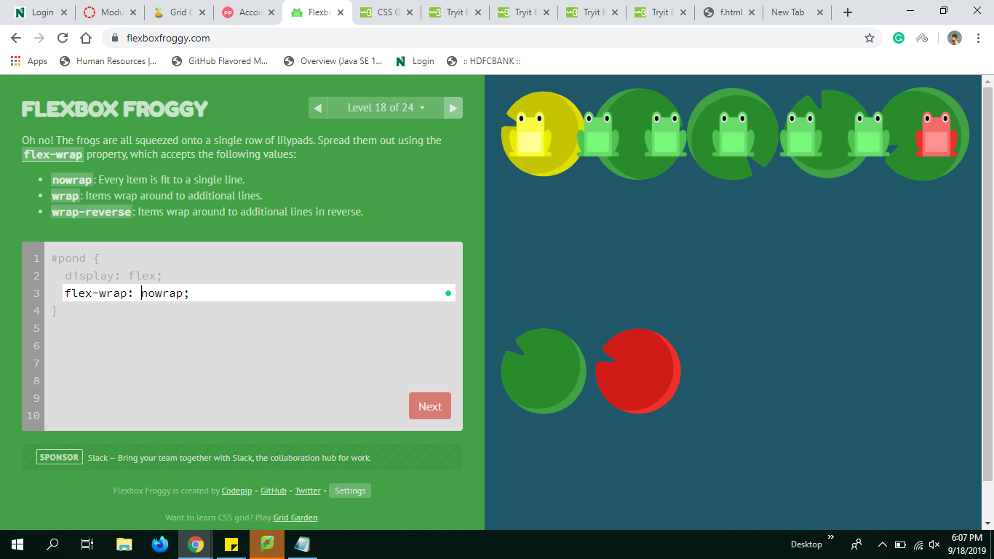
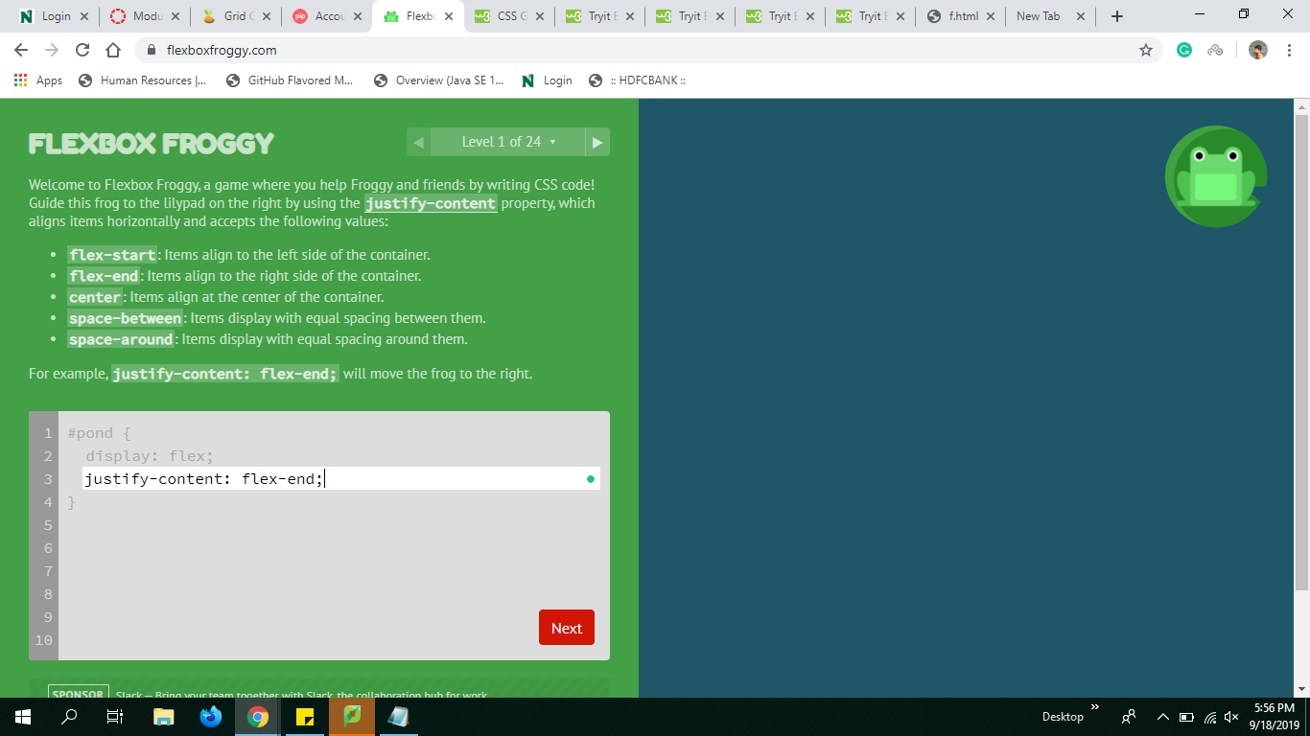
Flex-wrap
The flex-wrap property specifies whether the flex items should wrap or not.
a. wrap nowrap
wrap-reverse

Slide 9
Justify contents
The justify-content property is used to align the flex items. The alignment can be done on the items in that division.
Properties:
a. center
b. flex-start
c. flex-end
d. space- around
e. space-between

